Slide 1
When Wireless Communications Meet Artificial Intelligence
Mugen Peng (pmg@bupt.edu.cn)
Beijing University of Posts & Telecommunications
2017-11-19

Slide 2
Outline
Background
Supervised Learning
Unsupervised Learning
Transfer Learning
Reinforcement Learning

Slide 3
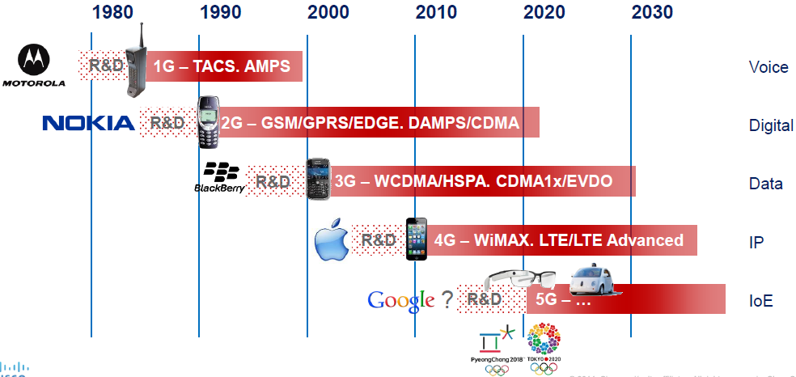
Cellular Evolution
Source: Cisco

Slide 4
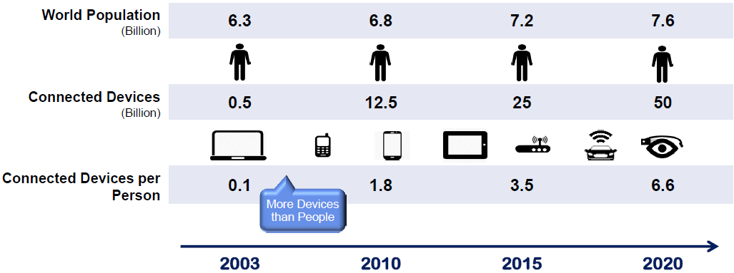
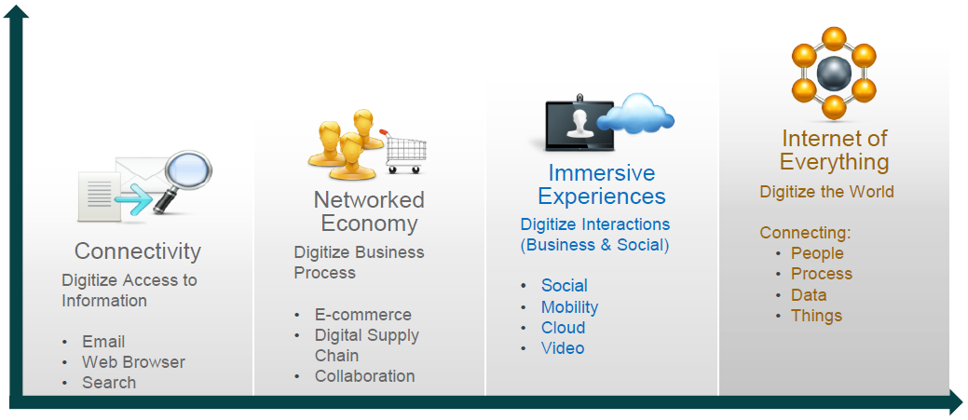
Internet of Thing
Source: Cisco

Slide 5
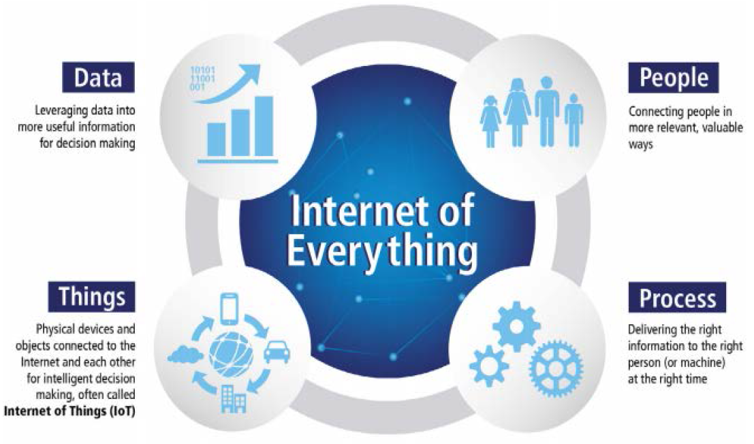
IoT -> IoE

Slide 6
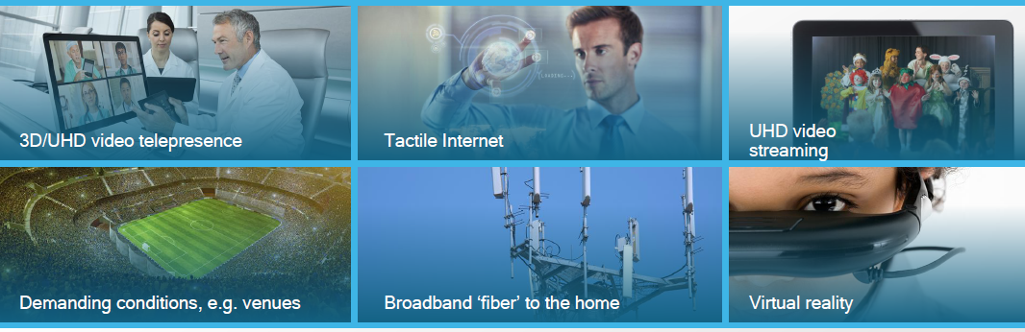
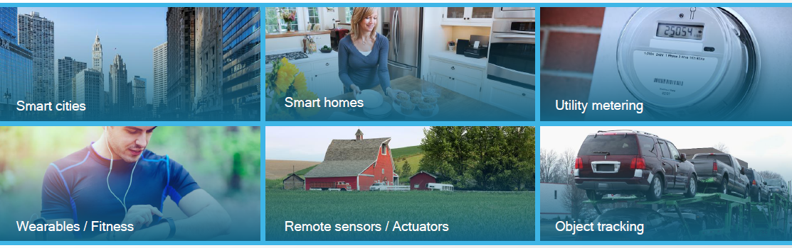
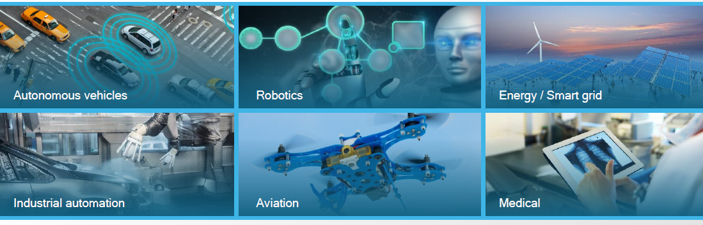
5G Application Scenarios
Enhanced Mobile Broadband
G**bytes in a second
Super Bit Rate for eMMB
3D voice_UHD_**
Smart Home Building
Work and play in cloud
****
Industry au***
voice
Mission office application
Future IMT
Energy-efficient & Massive connections for IoT
Smart City
Self Driving Car
High reliability and low latency MTC

Slide 7
5G Challenges
Complexity of future wireless access networks
Multi-RAT, Multi-layer, Multi-vendor
Multitude of tunable radio parameters
Higher dynamicity
Higher end user expectation
Growing pressure for higher network management efficiency
Operability (OPEX )
Operational efficiency (CAPEX )
Customer satisfaction

Slide 8

Solutions：AI based 5G/5G+
Regular Cellular
Networking
Random and
Heterogeneous 5G/5G+
Networking refinement
AI based Networking
Big data and learning
Network Planning & Optimization
Measurement Report
Data Mining
Real-time Feedback
Social-awareness
Drive Test & Point Test
Huge Human Resource
Not General

Slide 9
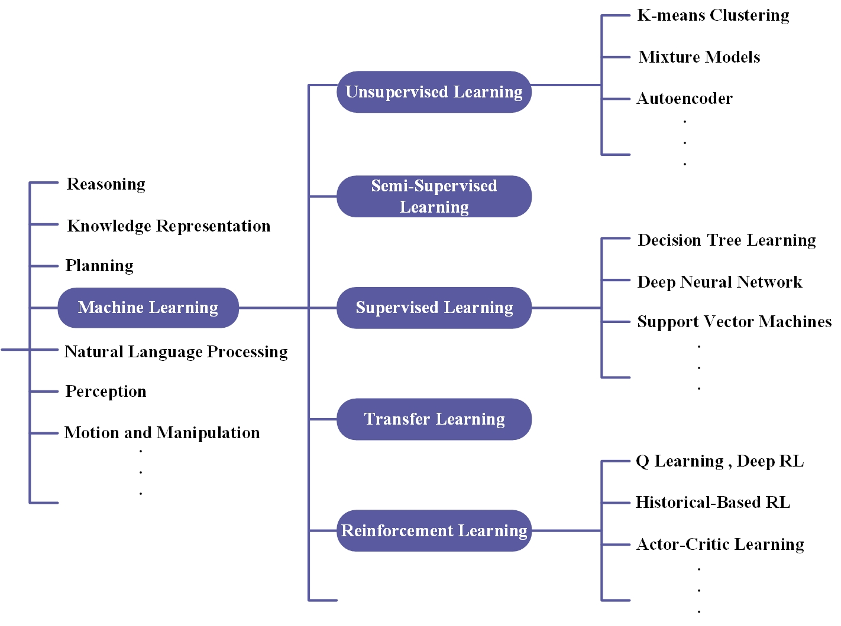

AI Definition
Artificial intelligence (also machine intelligence, MI) is intelligence displayed by machines, in contrast with the natural intelligence (NI) displayed by humans and other animals. (from wiki)
The scope of AI research is broad:

Slide 10
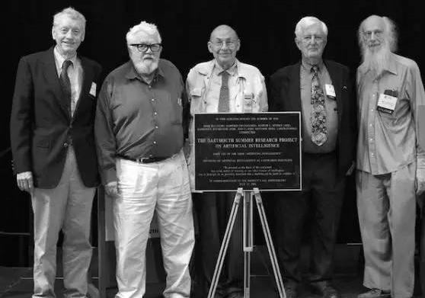
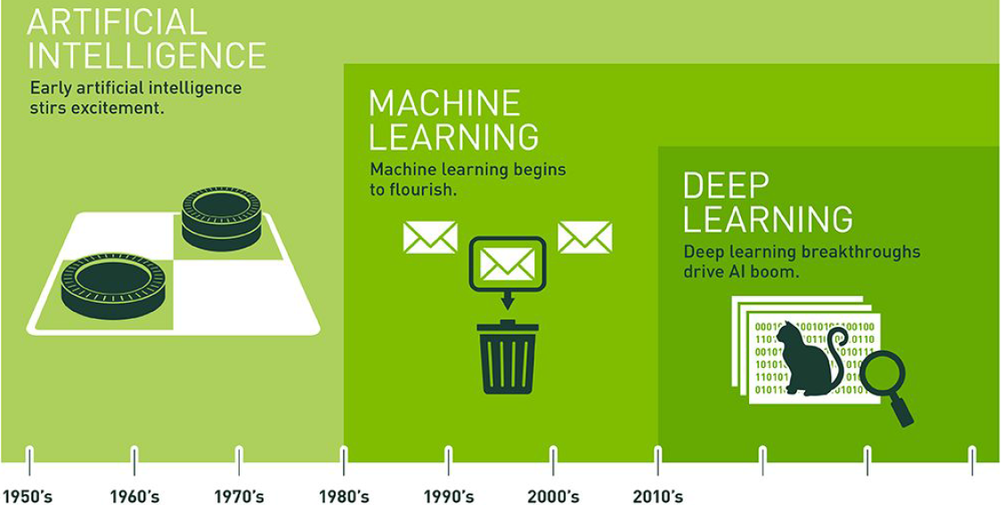
The birth of AI: 1956
At the Dartmouth workshop of 1956's, Allen Newell, Herbert A. Simon and Cliff Shaw debuted with Logic Theorist

Slide 11
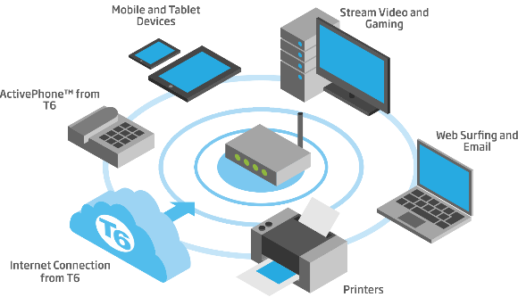







AI Applications
Pattern Recognition
Communications
Computer Vision
Example:
Knowledge
bases
Example:
Logistic
Regression
Data Mining
Voice Recognition
Examples:
DNN
Statistics
Natural Language Processing

Slide 12
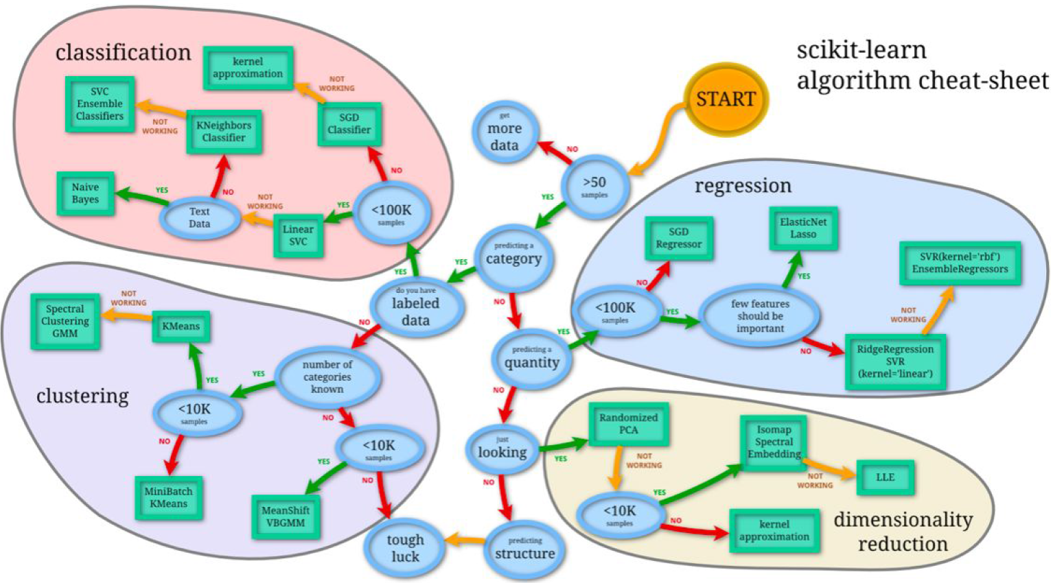
AI and Learning
Systems that think like humans
Systems that act like humans
Systems that think rationally
Systems that act rationally

Slide 13
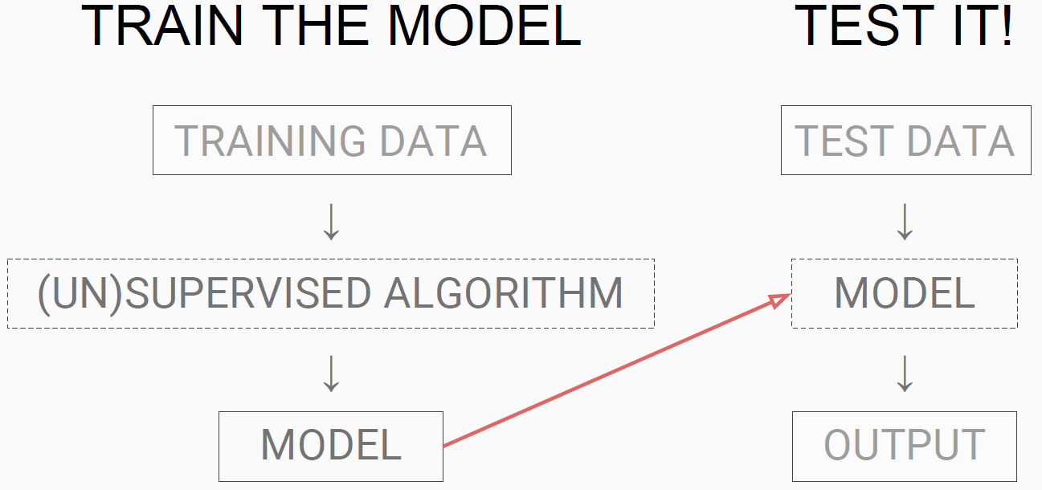
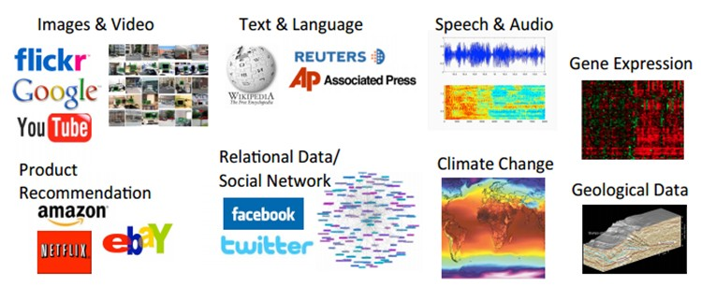
Machine Learning
Machine learning explores the study and construction of algorithms that can learn from and make predictions on data

Slide 14
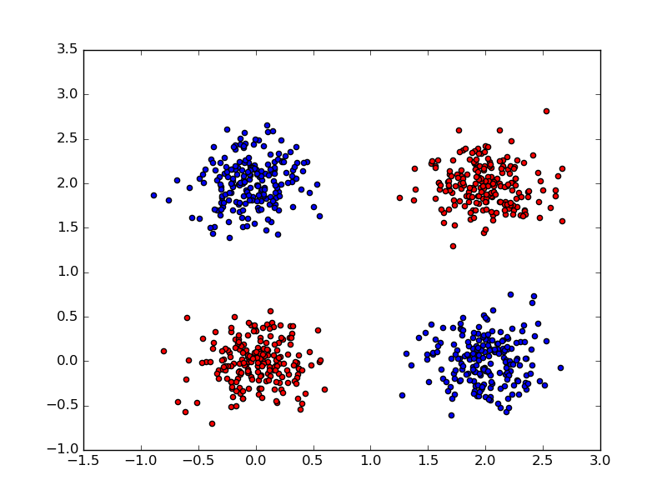
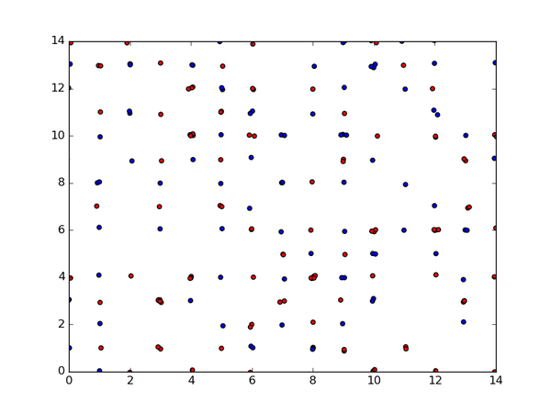
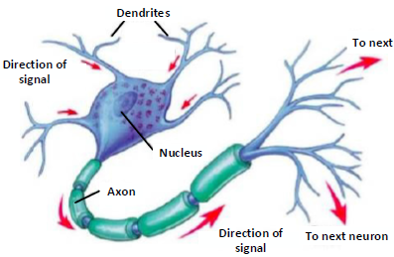
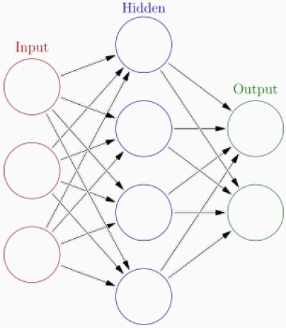
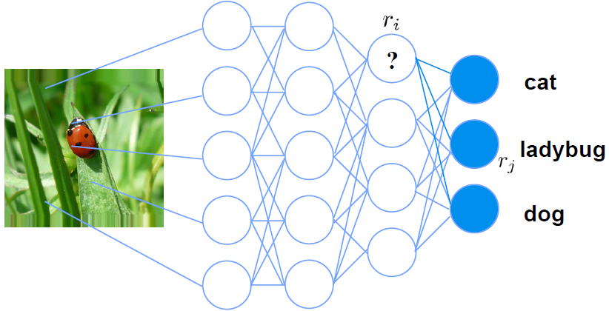
Deep Learning
Deep learning is a neural network with one or more hidden layers
Machine Learning
Deep Learning

Slide 15
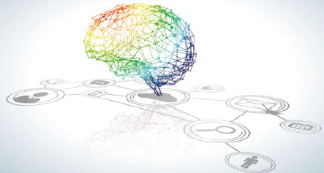
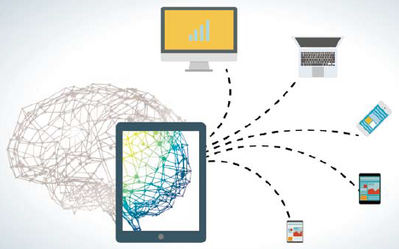
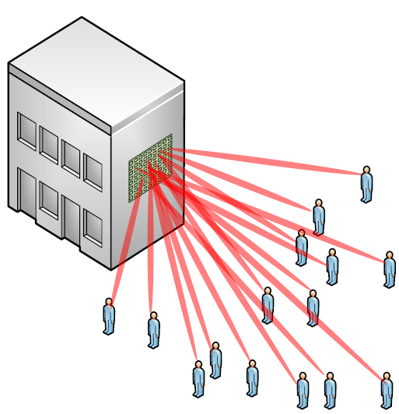
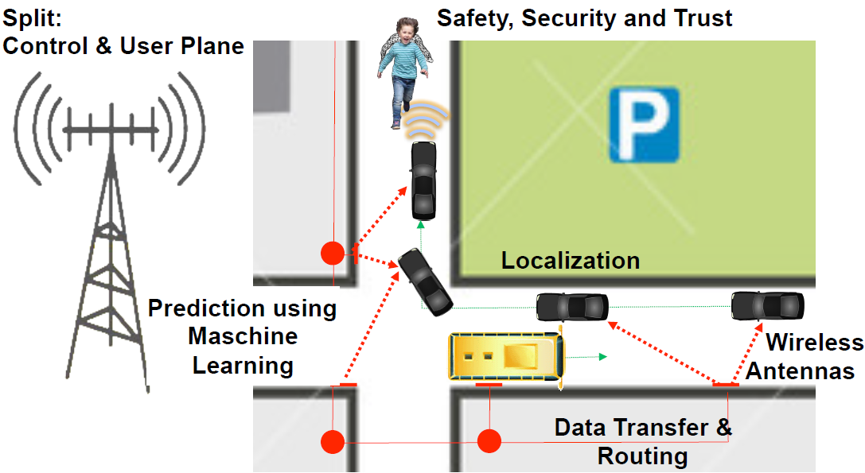
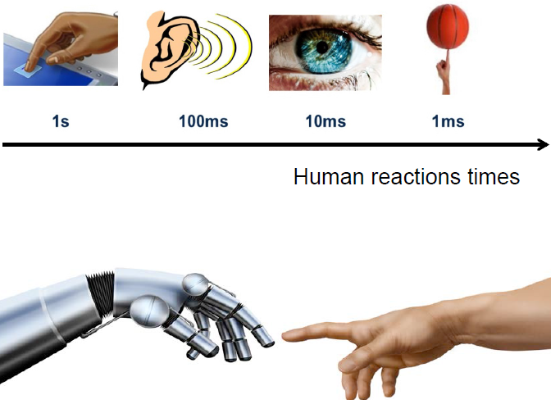
AI-enabled Wireless Communications
Big data & complex networking in Wireless
AI-enabled technology and application
Massive MIMO
User-central Scheduling
New Application

Slide 16
Machine Learning
Unsupervised
Supervised
Clustering & Dimensionality
Reduction
Regression
Linear
Polynomial
Continuous
SVD
PCA
K-means
Decision Trees
Random Forests
Classification
Association Analysis
KNN
Trees
Logistic Regression
Naive-Bayes
SVM
Apriori
FP-Growth
Categorical
Hidden Markov Model

Slide 17
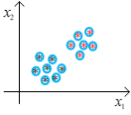
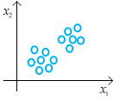
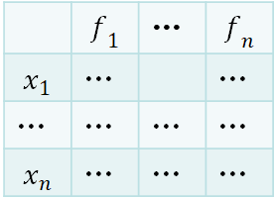
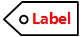
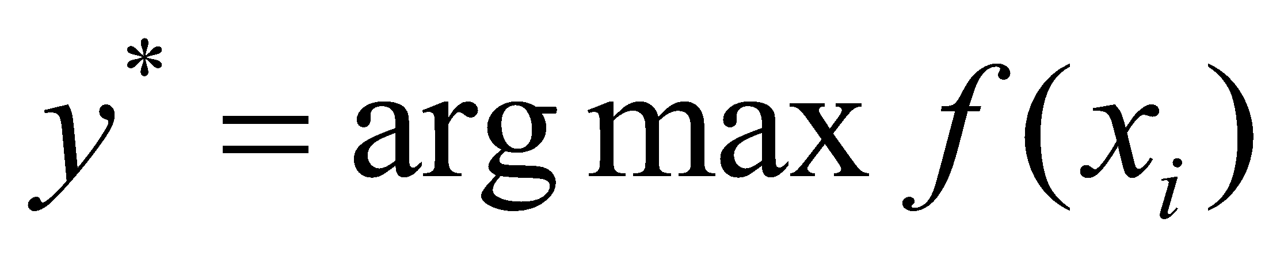
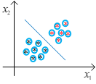
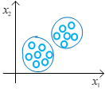
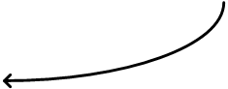


Key Steps for Machine Learning
labeled
unlabeled
3）Learning function
1） Training data
2） Feature extraction
4）Prediction

Slide 18
Outline
Background
Supervised Learning
Unsupervised Learning
Transfer Learning
Reinforcement Learning

Slide 19
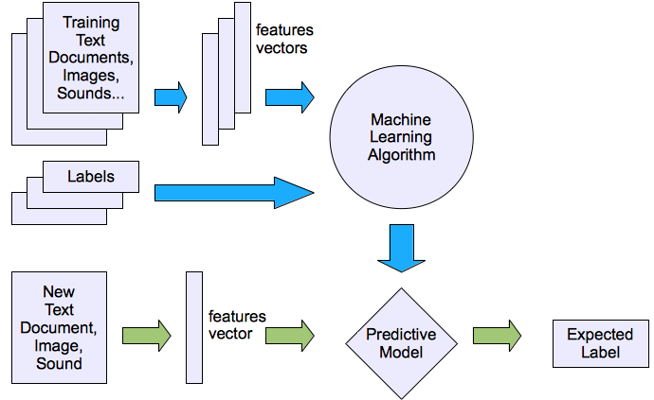
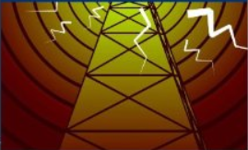
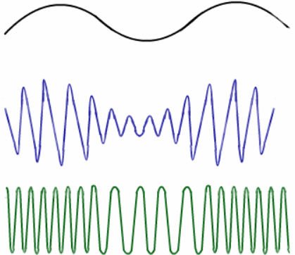

Supervised Learning
Concept of SL
SL for Wireless Communications
SL refers to the machine learning task of inferring a function from labeled training data (from wiki)
The labeled data may not be easy to acquired
Channel Estimation
User Location Prediction
Signal Parameter Estimation

Slide 20
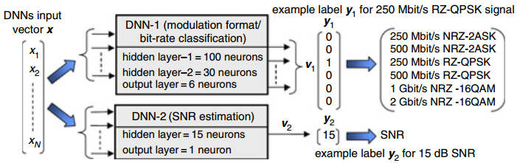
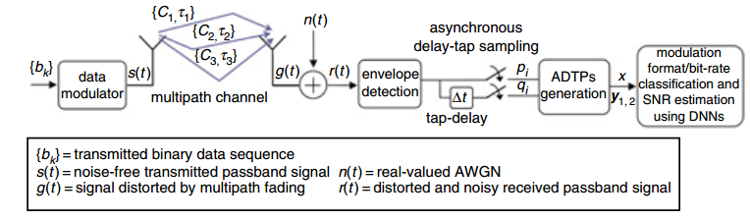
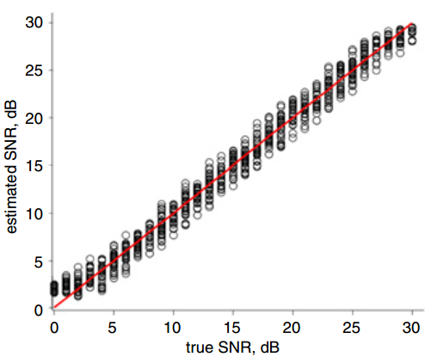
DNN in Signal Parameter Estimation
An effective deep neural network (DNN) model for signal parameter estimation including the modulation format and signal-to-noise ratio
Signal’s asynchronous delay tap plots(ADTPs)
High accuracy for SNR estimation with low-speed, asynchronous sampling
Reference: F. N. Khan and C. Lu; A. P. T. Lau, ”Joint modulation format/bit-rate classification and signal-to-noise ratio estimation in multipath fading channels using deep machine learning,” Electron. Lett., vol. 52, no. 14, pp. 1272-1274, Jul. 2016.

Slide 21
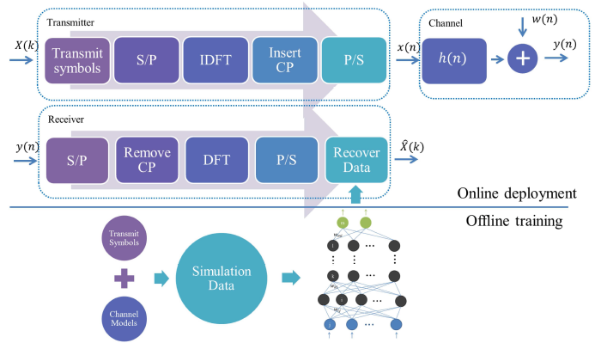
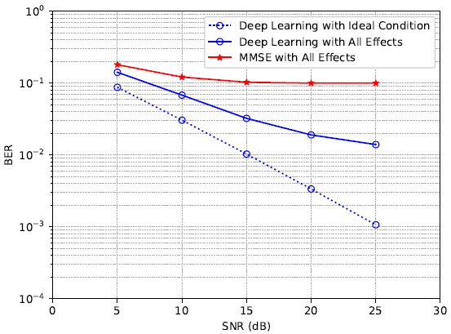
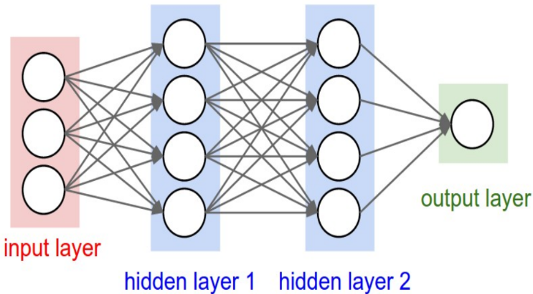
DNN in Channel Estimation
An effective deep neural network (DNN) model for joint channel estimation and symbol detection
Deep learning gains
Reference: H. Ye, G. Y. Li, and B. Juang, ”Power of deep learning for channel estimation and signal detection in OFDM systems,” IEEE Wireless Commun. Lett., doi:10.1109/LWC.2017.2757490

Slide 22
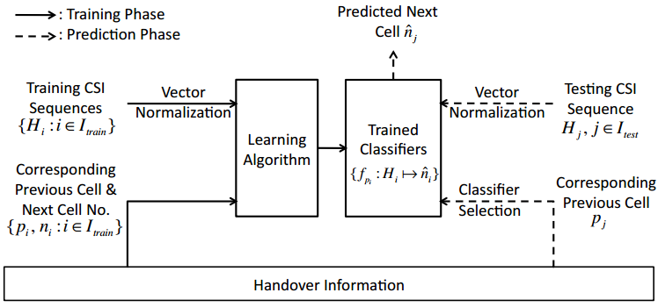
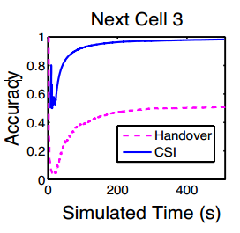

SVM in User Location Prediction
An effective support vector machine (SVM) based approach for predicting the user’s next cell
Incorporating CSI together with handover history as input in SVM can achieve much higher prediction accuracy
Using handover history alone
Deal with the inaccurate prediction of linear SVM by involving Gaussian kernel
Reference: X. Chen, F. Mériaux, and S. Valentin, ”Predicting a user's next cell with supervised learning based on channel states,” in Proceedings of SPAWC, Darmstadt, Germany, pp. 36-40, Jun. 2013.

Slide 23
Outline
Background
Supervised Learning
Unsupervised Learning
Transfer Learning
Reinforcement Learning

Slide 24
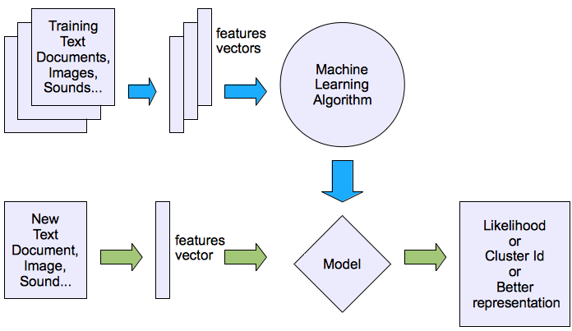
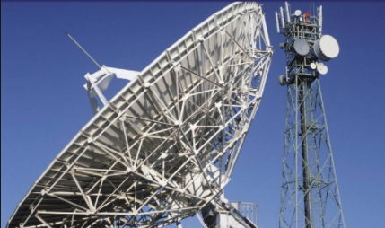
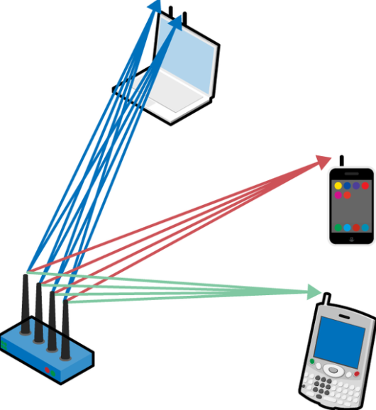
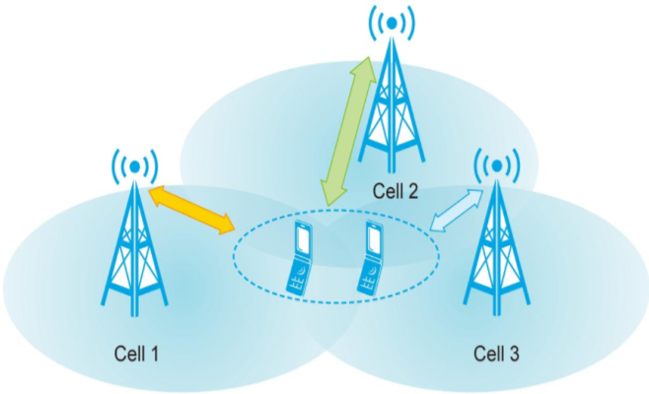
Unsupervised Learning
Concept of USL
USL in Wireless Communications
USL refers to the learning task of inferring a function to describe hidden structure from unlabeled data (from wiki)
It is often easier to obtain unlabeled data than labeled data
Spectrum Sensing
Signal Detection
Base Station Clustering

Slide 25
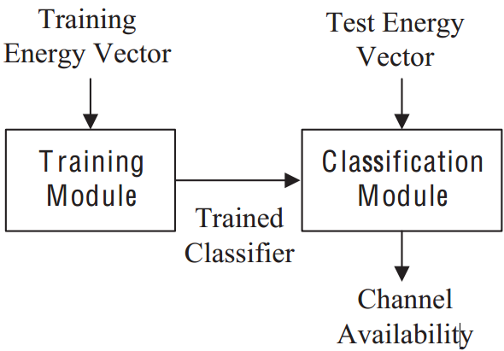
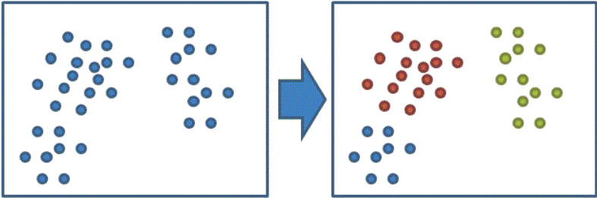
K-Means in Spectrum Sensing (1)
An effective K-Means model for cooperative spectrum sensing (CSS) in cognitive radio networks
In the context of CSS, the “energy vector” is treated as a feature vector, each component of which is an energy level estimated at each CR device
Energy vectors are clustered into multiple clusters by K-means method, each of which corresponds to a channel available state
Reference: K. Thilina, K. Choi, N. Saquib, and E. Hossain, ”Machine learning techniques for cooperative spectrum sensing in cognitive radio networks,” IEEE J. Sel. Areas Commun., vol. 31, no. 11, pp. 2209-2221, Nov. 2013.

Slide 26
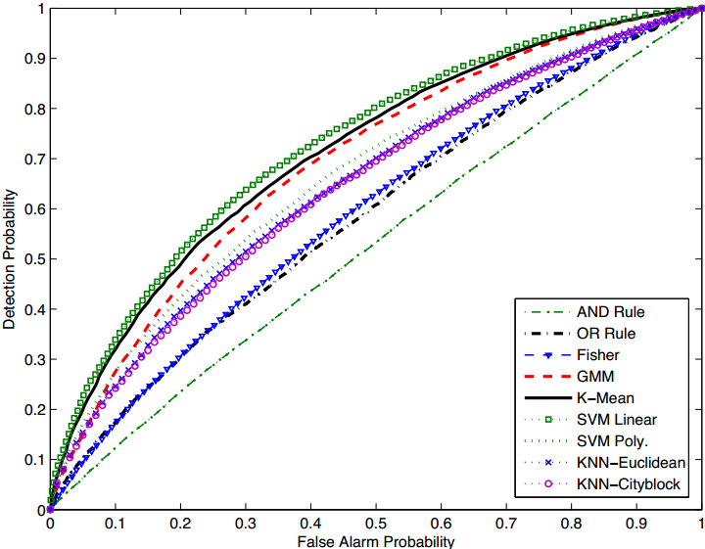

K-Means in Spectrum Sensing (2)
Main Contributions
The unsupervised K-means classifier achieves the performance comparable to the supervised SVM-Linear classifier
The K-means classifier achieves performance which is comparable to that of the supervised learning schemes even when the transmission power of a primary user is low
The probability that a primary user is correctly detected
Similar Performance
The probability that a non-existent primary user is detected
K-means based CSS
Reference: K. Thilina, K. Choi, N. Saquib, and E. Hossain, ”Machine learning techniques for cooperative spectrum sensing in cognitive radio networks,” IEEE J. Sel. Areas Commun., vol. 31, no. 11, pp. 2209-2221, Nov. 2013.

Slide 27



Auto-encoder in Signal Detection
An effective auto encoder based model for signal detection in MIMO-OFDM networks
The autoencoder is used to extract the features of the received signal, while the extreme learning machine is adopted as a fast classifier for the feature recognition
Learning based detection
State-of-the-art methods
Optimal detection
Traditional methods
Reference: X. Yan, F. Long, J. Wang, N. Fu, W. Ou, and B. Liu, ”Signal detection of MIMO-OFDM system based on auto encoder and extreme learning machine,” in Proceedings of IIJCNN, Anchorage, AK, USA, pp. 1602-1606, May 2017.

Slide 28
Outline
Background
Supervised Learning
Unsupervised Learning
Transfer Learning
Reinforcement Learning

Slide 29




Transfer Learning
Concept of TL
TL is a research problem in machine learning that focuses on storing knowledge gained while solving one problem and applying it to a different but related problem (from wiki)
TL into Wireless Networking
BS Switching
Spectrum Management
Cache Placement

Slide 30


TL in Green RANs（１）
A transfer actor-critic learning approach in green RANs for base station switching control to save energy
Transferring the learned BS switching strategy in former period to the current period, learning can be speeded up
Reference: R. Li, Z. Zhao, X. Chen, J. Palicot, and H. Zhang, ”TACT: A transfer actor-critic learning framework for energy saving in cellular radio access networks,” IEEE Trans. Wireless Commun., vol. 13, no. 4, pp. 2000-2011, Apr. 2014.

Slide 31


TL in Green RANs（２）
Main Contributions
The actor-critic algorithm with knowledge transfer converges faster than the classical actor-critic scheme
Higher similarity between the source task and the target task leads to a more efficient transfer effect
Classical actor-critic algorithm
Optimal scheme with full knowledge
A measure of the similarity between the source task and the target task
Reference: R. Li, Z. Zhao, X. Chen, J. Palicot, and H. Zhang, ”TACT: A transfer actor-critic learning framework for energy saving in cellular radio access networks,” IEEE Trans. Wireless Commun., vol. 13, no. 4, pp. 2000-2011, Apr. 2014.

Slide 32



TL in Spectrum Management
A transfer actor-critic learning approach in cognitive radio networks (CRNs) for CR users to make spectrum utilization decisions
The secondary user (SU) which is new to CRN can use the matured experience of the existing expert SUs which have similar QoS requirements
RL with knowledge transfer
Knowledge transfer enables better performance and quick convergence
Reference: A. Koushik, F. Hu, and S. Kumar, ”Intelligent spectrum management based on transfer actor-critic learning for rateless transmissions in cognitive radio networks,” IEEE Trans. Mobile Comput., doi:10.1109/TMC.2017.2744620

Slide 33
Outline
Background
Supervised Learning
Unsupervised Learning
Transfer Learning
Reinforcement Learning

Slide 34




Reinforcement Learning
Concept of RL
RL in Wireless Networking
RL is an important branch of machine learning, where an agent makes interactions with an environment
The agent would like to optimize a long term accumulated reward by taking a sequence of actions
Vehicular Network
Cloud RANs
D2D Network
Notes:
参考： https://en.wikipedia.org/wiki/Reinforcement_learning
Concept of RL:
Goal: Reinforcement learning (RL) is an area of machine learning inspired by behaviourist psychology, concerned with how software agents ought to take actions in an environment so as to maximize some notion of cumulative reward.
Feature:
1、In machine learning, the environment is typically formulated as a Markov decision process (MDP), as many reinforcement learning algorithms for this context utilize dynamic programming techniques.^{[1]} The main difference between the classical techniques and reinforcement learning algorithms is that the latter do not need knowledge about the MDP and they target large MDPs where exact methods become infeasible.
2、Reinforcement learning differs from standard supervised learning in that correct input/output pairs are never presented, nor sub-optimal actions explicitly corrected. Instead the focus is on on-line performance, which involves finding a balance between exploration (of uncharted territory) and exploitation (of current knowledge).^{[2]} The exploration vs. exploitation trade-off in reinforcement learning has been most thoroughly studied through the multi-armed bandit problem and in finite MDPs
RL into Wireless Networking
MDP/POMDP ---Energy Harvest, Cognitive Radio
Multi-Armed Bandits: D2D Networks

Slide 35


RL Review
Reinforcement learning from “non-working” to “working”, due to Deep Learning, so often call DRL
V. Mnih, etc., Human-level control through deep reinforcement learning, Nature, Vol. 518, No. 7540, 2015, pp. 529-533.
Deep Q-Network (DQN) can learn policies directly from high-dimensional sensory inputs.

Slide 36

Historical RL in Vehicular Networks (1)
A historical-based RL approach in vehicular networks for base station association in a dynamic environment
Each base station records their experienced association together with corresponding radio environment (association pattern)
Once the environment similar to that in the recorded pattern occurs, the base station makes association decisions based on the association in that pattern
Reference: Z. Li, C. Wang, and C. Jiang, ”User association for load balancing in vehicular networks: An online reinforcement learning approach,” IEEE Trans. Intell. Transp. Syst., vol. 18, no. 8, pp. 2217-2228, Aug. 2017.
Notes:
参考文献： Zhong Li，et al. “User Association for Load Balancing in Vehicular Networks_ An Online Reinforcement Learning Approach”.IEEE Transactions on Intelligent Transportation Systems ， Volume: 18, Issue: 8, Aug. 2017
Under the traditional max-SINR scheme, a powerful/strong base station may attract more vehicles to associate with it, as illustrated in Fig.1. Even with a targeted deployment where the weak base stations are placed in the dense traffic areas, most vehicles still receive the powerful downlink signal from the strong base stations. This will result in the strong ones having heavy loads while the weak ones having many idle resources. For vehicles, even they associate with the strong base stations, the service rates are still very bad, since the strong ones serve too many vehicles. So, a more balanced association scheme is needed for vehicular networks.
Fortunately, we find that in vehicular networks, there exists potential regularities of spatial-temporal distribution for traffic flows every day. The goal of our study is to learn and utilize the spatial-temporal association experiences.
When the network keeps up changing, the base station uses a ε greedy method to learn the association actions based on its historical association patterns (decisions).
Challenge
Unfortunately, most popular optimization technologies, like gradient descent method, Lagrange multiplier method, only apply to the scenario where the traffic flow generated by mobile users is approximately static. They assume the channel quality is stable. However, in real world, the change of the traffic is not stable. The assumption results in the invalidation of association solution. Even if we apply them in the unknown dynamic environment, the lack of feedback signals from environment causes the gradient descent losing its direction. Besides, once the network scenario changes, the traditional association algorithms must rerun in the whole network with high costs.
Benefits:
The goal of our study is to learn and utilize the spatial-temporal association experiences so as to directly obtain the association solution in the dynamic vehicular environment.

Slide 37


Historical RL in Vehicular Networks (2)
Main Contributions
The historical-based RL approach can alleviate the asymmetric load problem
The historical-based RL approach provides a more uniform user experience with higher service rates
Largest
Service Rate
Utility maximization approach
Smallest
Variance
Online RL approach
Reference: Z. Li, C. Wang, and C. Jiang, ”User association for load balancing in vehicular networks: An online reinforcement learning approach,” IEEE Trans. Intell. Transp. Syst., vol. 18, no. 8, pp. 2217-2228, Aug. 2017.
Notes:
参考文献： Zhong Li，et al. “User Association for Load Balancing in Vehicular Networks_ An Online Reinforcement Learning Approach”.IEEE Transactions on Intelligent Transportation Systems ， Volume: 18, Issue: 8, Aug. 2017
Fig1: Number of associations in three ties of base stations.
Fig2: The distribution of service rates.
Fig.1 we capture the association results when convergence ends. The max-SINR association results in unbalanced loads, in which the macrocells are over-loaded, while the picocells and femtocells only serve fewer users. In ORLA, the load is shifted to the less congested femtocells, which suggests that our scheme ORLA alleviates the asymmetric load problem. It shows the effectiveness of ORLA. The results of 3D and ORLA are similar since the near-optimal results are both obtained by them.
Fig.2 shows the distribution of service rates for 20 high-activity vehicles. By using the statistical tools in MAT-LAB, in Fig.8, the overall service rates are 0.1051bits/s/Hz, 0.1096bits/s/Hz and 0.1296bits/s/Hz for max-SINR, 3D and ORLA, respectively. Meanwhile, the variance values of service rates are 4.2359e-005, 3.0072e-005 and2.3642e-005 for maxSINR, 3D and ORLA, respectively. We obtain that ORLA has the largest overall service rates with smallest variance value. Therefore, combining Fig.7 with Fig.8, we can see that ORLA provides a more uniform user experience with higher service rates for vehicles. It also benefits the overall performance of the whole network system.

Slide 38




Deep RL in Cloud RANs
A deep RL approach in cloud RANs for energy consumption minimization by RRH switching control and precoding design
A DNN is utilized to approximate the Q value for each state-action pair
The input state includes the on-off states of all the RRHs and the performance requirement of each user
Full Coordinated Association
Precoding design
RRH switching
Single BS
Association
Reference: Z. Xu, Y. Wang, J. Tang, J. Wang, and M. Gursoy, ”A deep reinforcement learning based framework for power-efficient resource allocation in cloud RANs,” in Proceedings of ICC, Paris, France, pp. 1-6, May 2017.
Notes:
图中声明： 1) Single BS Association (SA): every user is associated only with a randomly chosen RRH and the set of RRHs without any association are turned into sleep. 2) Full Coordinated Association (FA): all RRHs are turned on and a user can be associated with multiple RRHs.
1、in Fig. 2(a), when the user demand is 10Mbps, the power consumption given by DRL is about 18% less than that of FA. Interestingly, DRL offers comparable or sometimes even better performance than SA. That is because SA randomly chooses a RRH to serve a user, while DRL tends to select the best RRH(s) for serving users under the guidance of a DNN.
2、As shown in Fig. 3, we can observe the fluctuation of power consumption due to the change of the user demand. Similar as in the above scenarios, DRL consistently outperforms FA in terms of total power consumption. This justifies effectiveness of DRL in highly dynamic cases. Note that we did not simulate SA in this scenario since sometimes it cannot satisfy the user demand.

Slide 39




Thanks！
Comments & Questions?

